Slide 1


Major Project
AdaptiPlan: Intelligent Scenario Modelling for
Climate Change Mitigation
Presented by:
R2142210244- Charu Gupta
R2142210448- Lakshay Agarwal
Mentored By:
Dr. Tanupriya Choudhury

Slide 2
Content
Introduction
Literature Review
Objectives
Methodology
References

Slide 3
Introduction
Technical Concepts (Algorithms):

Slide 4
Introduction
Motivation:
Problem Statement

Slide 5
Introduction
Area of application:
Dataset and input format

Slide 6
Literature Review
Cite Related work:

Slide 7
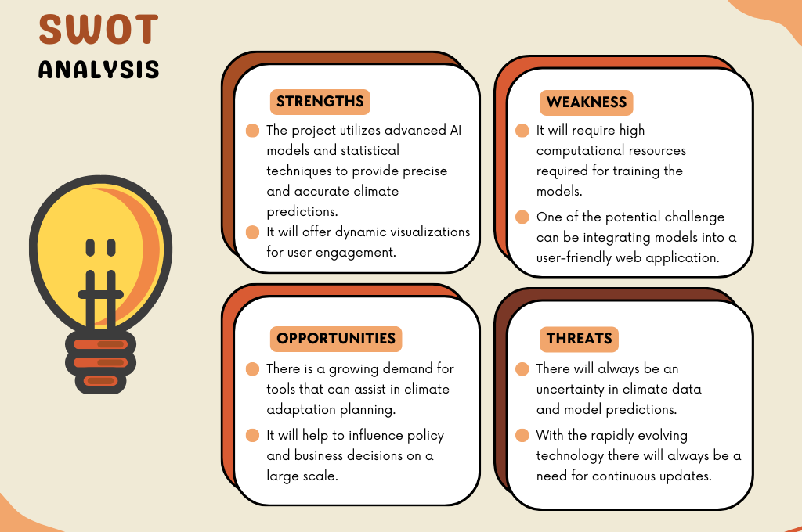
Literature Review

Slide 8
Objective
Main Objective:
The primary goals are:
To determine the most effective model for predicting climate change impacts.
Using it to develop an interactive web application for users.

Slide 9
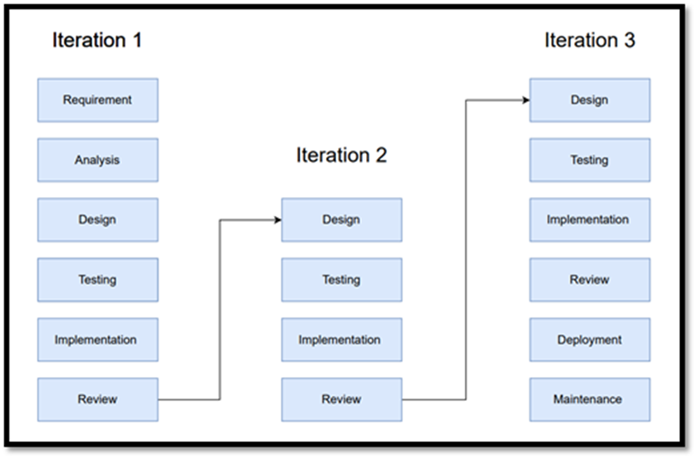
Methodology
Reference Software model
We will be using the Iterative Model to implement our project. The iterative method begins with a basic implementation of a limited set of software requirements in the iterative model, then repeatedly improves the evolving versions until the entire system is built and prepared for deployment.

Slide 10
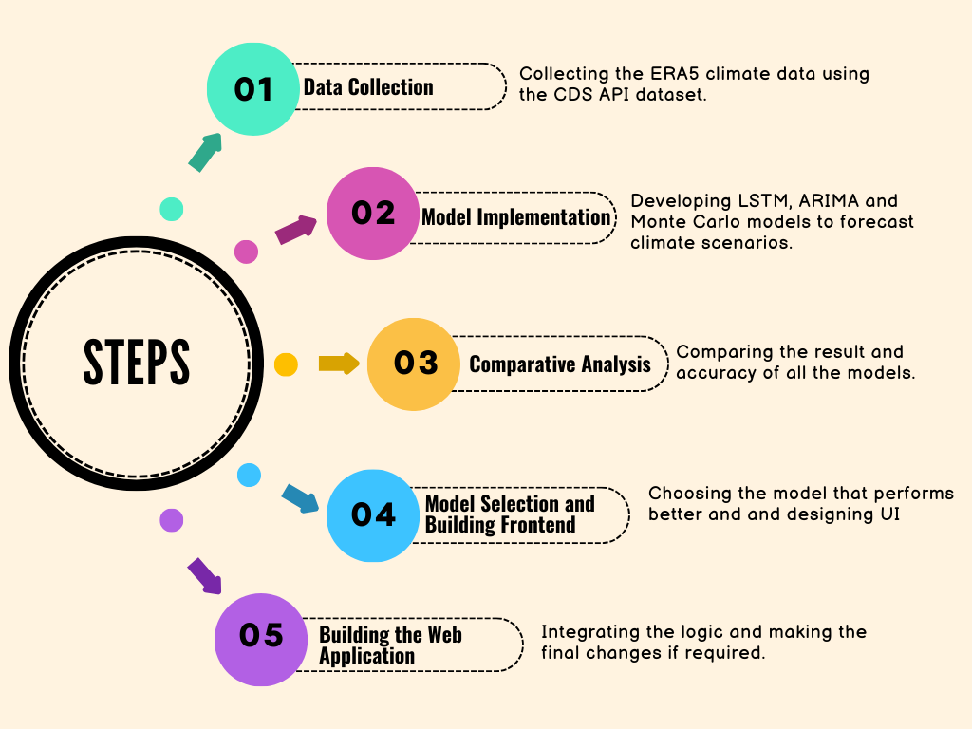
Methodology

Slide 11
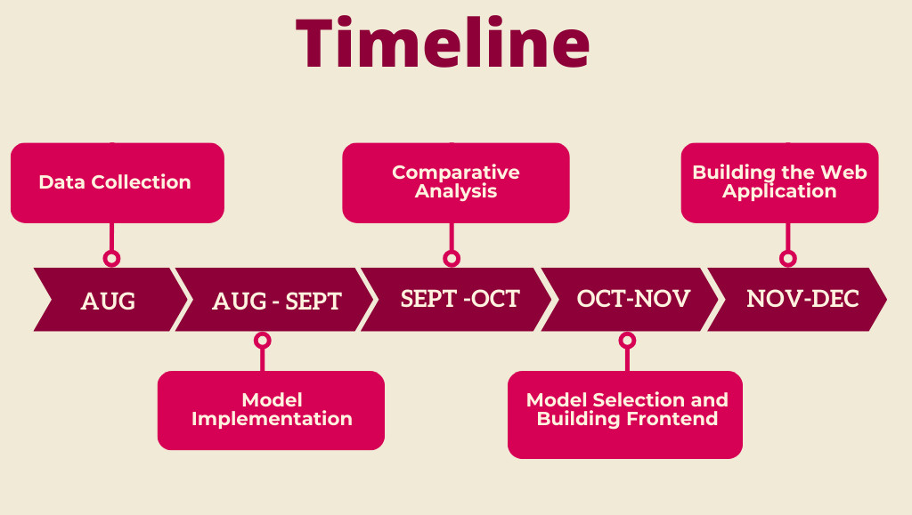
Methodology

Slide 12
Reference
List of cited papers

Slide 13
Thank You

